Slide 1

OS161-Virtual Memory with Demand Paging
Davide Milone
William Tessitore
Alessandro Campisi

Slide 2
Contents
Flow chart Algorithms
Memory management
Initialization
Allocation
De-allocation
Swap management
VM fault
Data structures
Frame Allocator
Allocation Size
Page Table
Entry Valid
Free Frame List
Swap File
Test

Slide 3

Flow Chart Algorithms

Slide 4
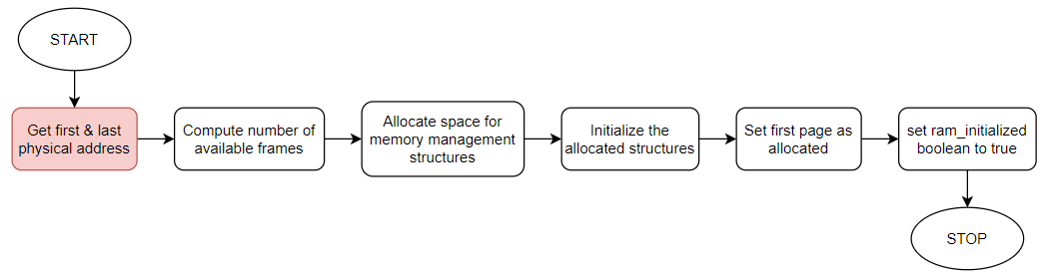
Memory management - Initialization

Slide 5
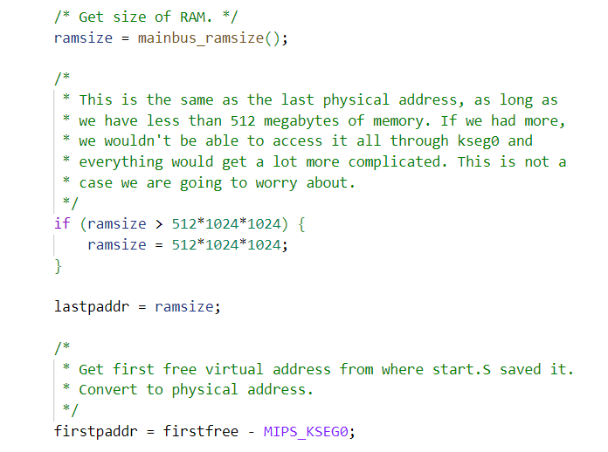
Memory management - Initialization

Slide 6
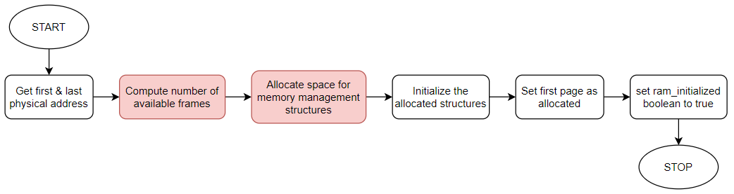
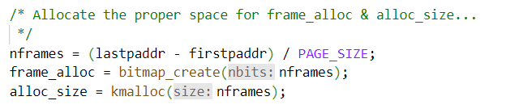
Memory management - Initialization

Slide 7
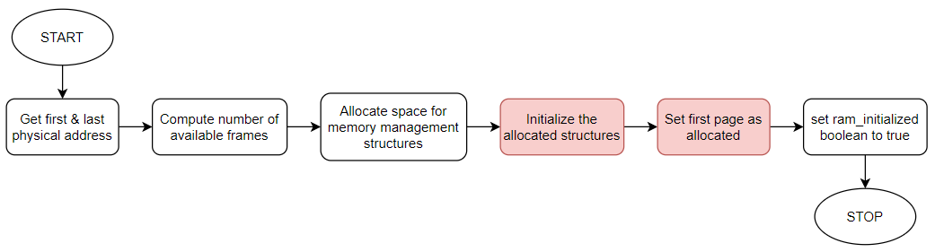
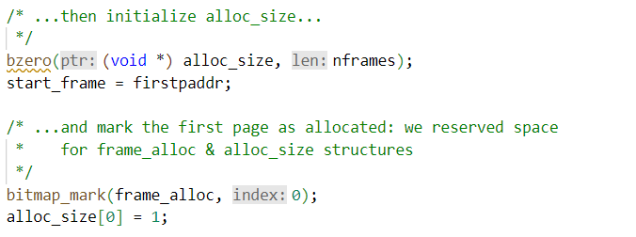
Memory management - Initialization

Slide 8
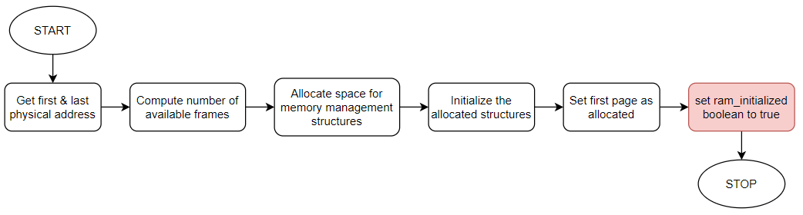
Memory management - Initialization

Slide 9
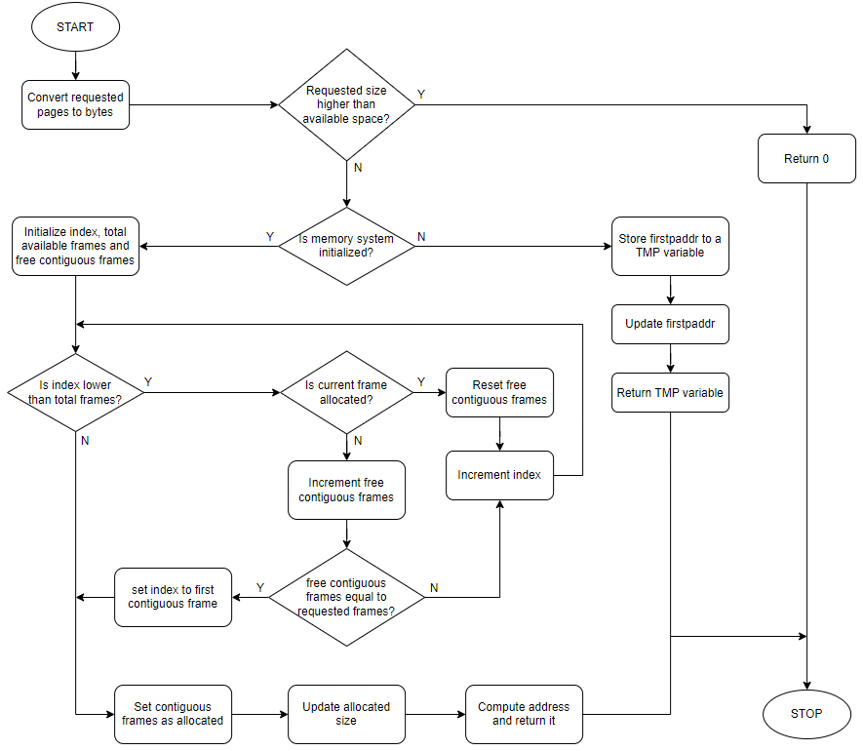
Memory management - Allocation

Slide 10
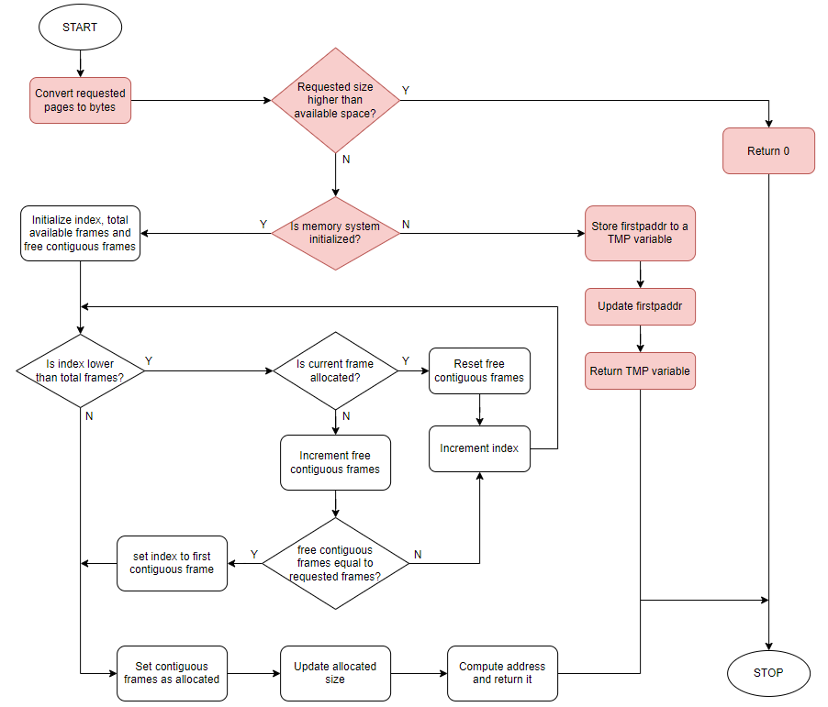
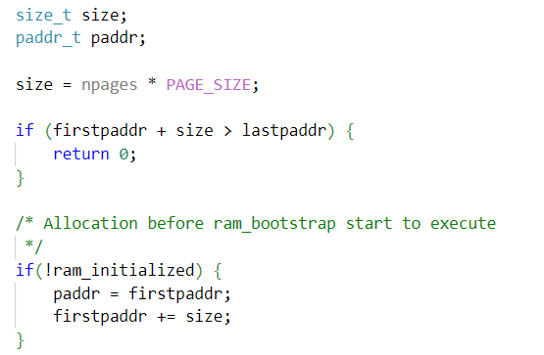
Memory management - Allocation

Slide 11
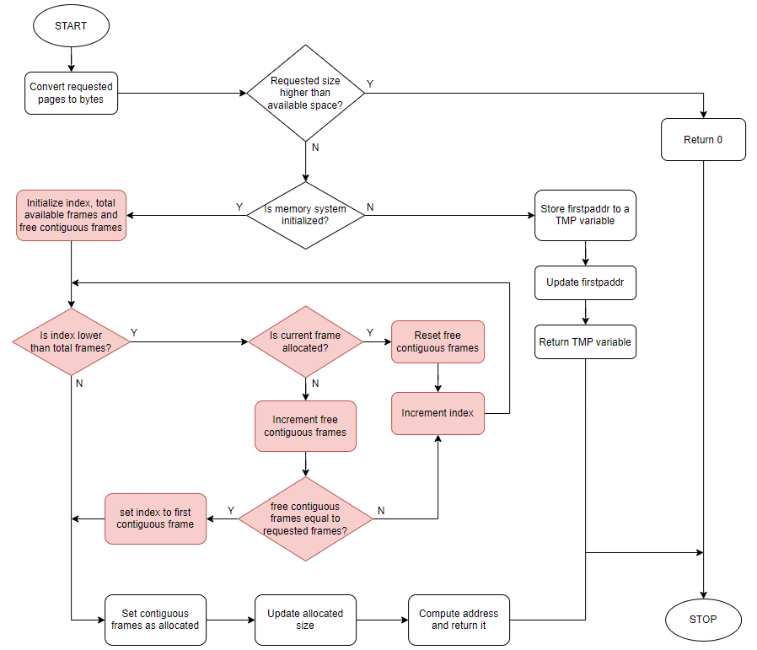
Memory management - Allocation

Slide 12
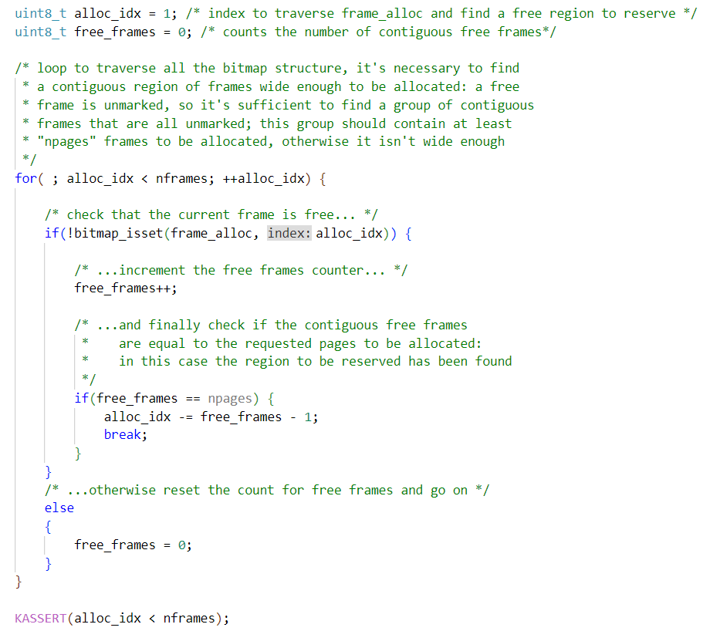
Memory management - Allocation

Slide 13
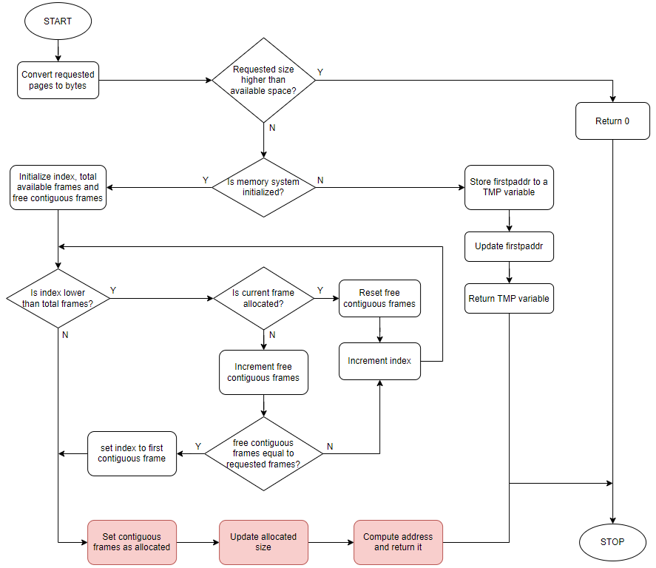
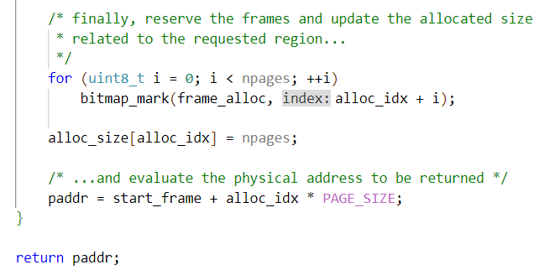
Memory management - Allocation

Slide 14
Memory management – De-Allocation

Slide 15
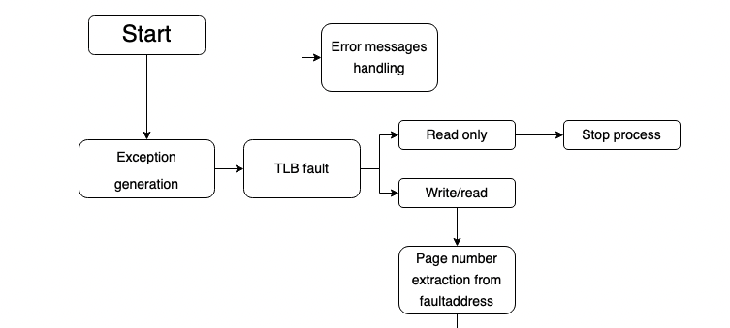
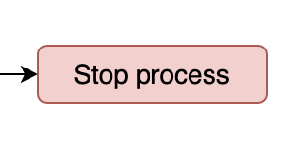
VM Fault 1/4

Slide 16
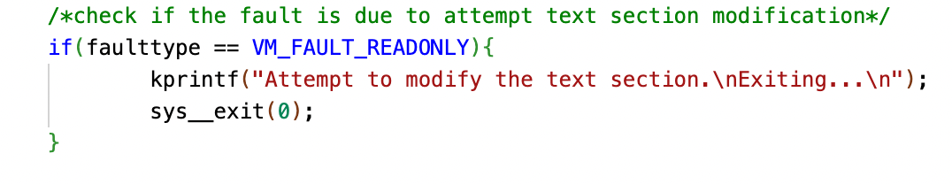
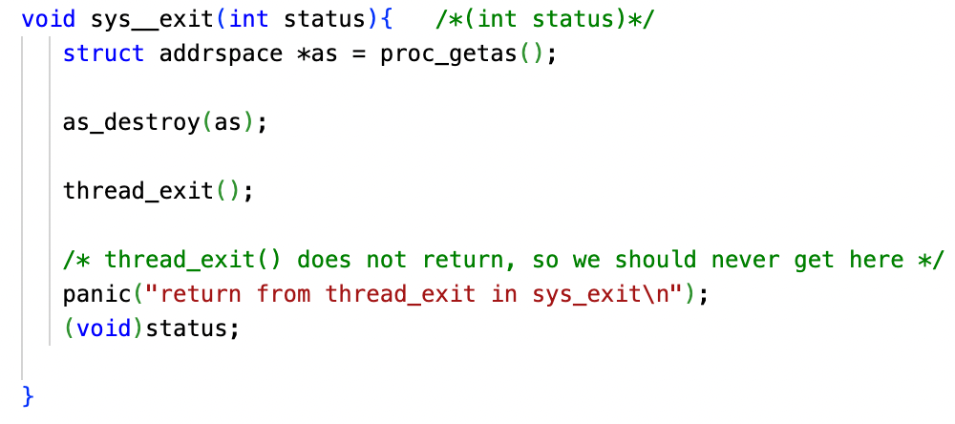
Stop process
Sys_exit(0)

Slide 17
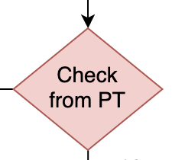
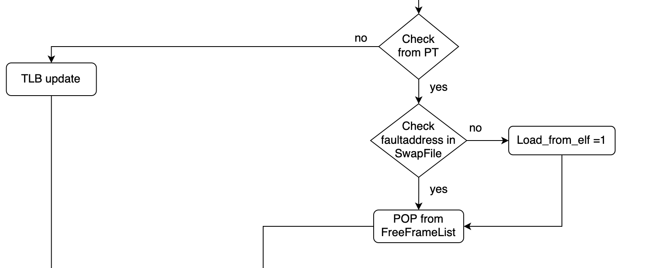
VM Fault 2/4

Slide 18

Check PT
Page entry validity should be checked to decide how to handle the fault
Two possibilities:
TLB fault
An actual page fault
Valid/Invalid entry depends on the entry content:
Different from NULL = frame address (valid entry)
Equal to NULL = invalid entry

Slide 19
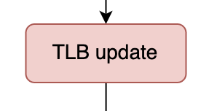
VM Fault 2/4

Slide 20
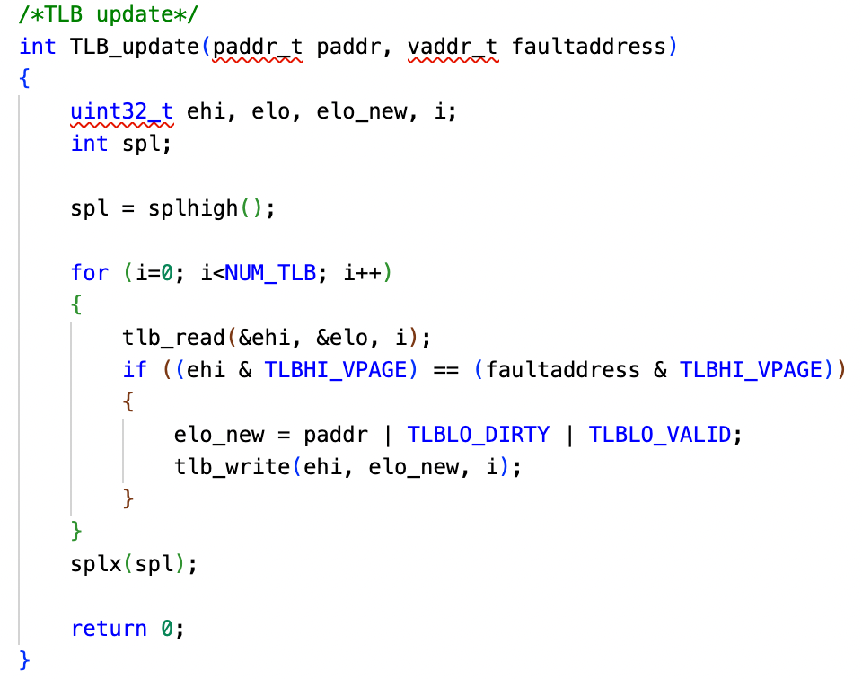
TLB update
TLB_update(paddr_t paddr, vaddr_t faultaddress)
Check the faultaddress in TLB
Updates the physical address paddr

Slide 21
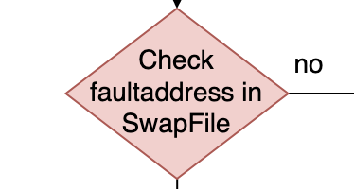
VM Fault 2/4

Slide 22
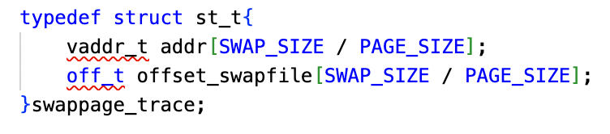
Swap File
Swappage_trace()
Vector of virtual addresses
Vector of offsets swapfile
Search_swapped_frame(vaddr_t vaddr)
Search vaddr address in Swappage_trace()
Returns offset in Swap File if the frame is present
Returns -1 if is not present

Slide 23
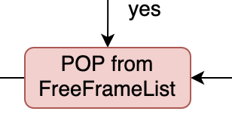
VM Fault 2/4

Slide 24
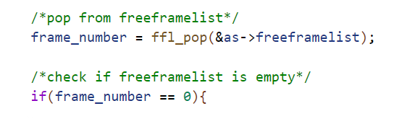
POP FreeFrameList
New frame address should be popped in case of a page fault
What if the free frame list is empty?
Need to check this case and decide how to go on
Return value from POP function is used:
Different from NULL = frame address available
Equal to NULL = free frame list empty (page replacement)

Slide 25
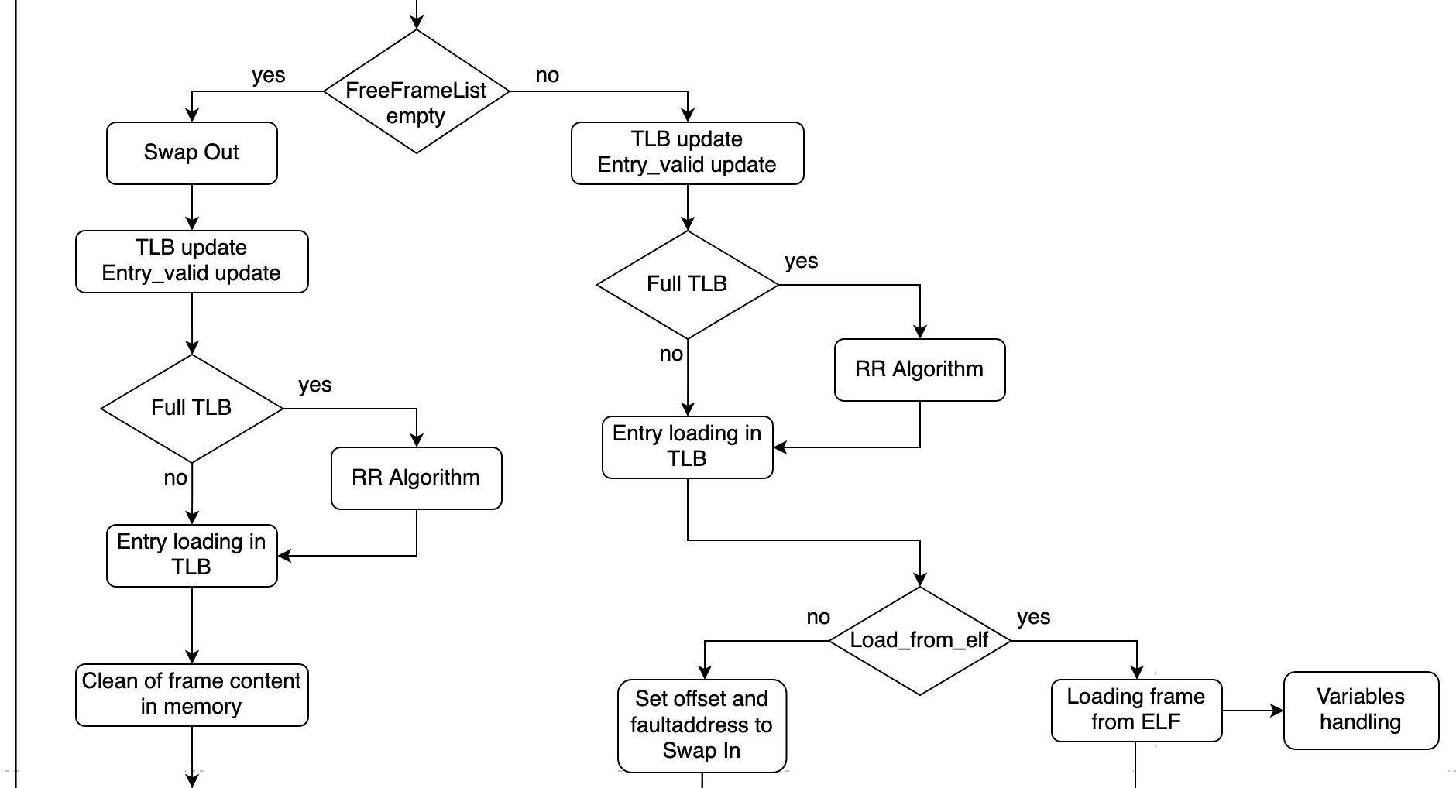
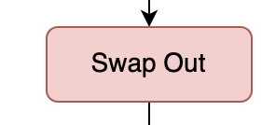
VM Fault 3/4

Slide 26
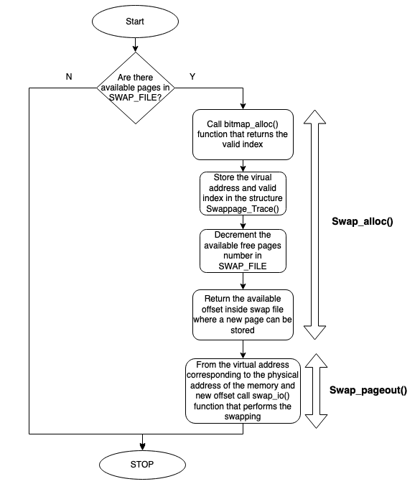
Swap OUT

Slide 27
Swap out
Swap_alloc(vaddr_t vaddr)
Search 0 in bit map structure and sets it to 1
Offset computation (index*PAGE SIZE)
Updates swappage_trace() (offset and physical addrres)
Swap_pageout(vaddr_t vaddr, off_t swapaddr)
Calls swap_io(vaddr_t vaddr, off_t swapaddr) function
Allocates pages in SwapFile

Slide 28
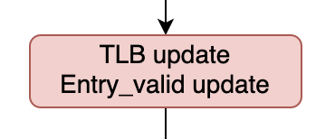
VM Fault 3/4

Slide 29
Entry_valid update

Slide 30
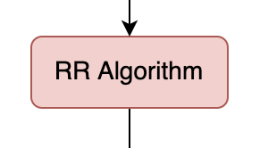
VM Fault 3/4

Slide 31
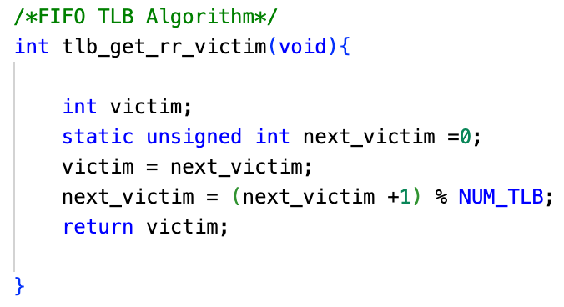
RR Algorithm
First IN First OUT Algorithm

Slide 32
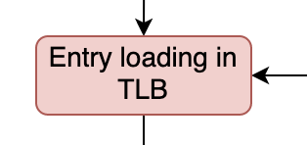
VM Fault 3/4

Slide 33
Entry Load TLB

Slide 34
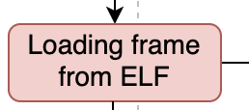
VM Fault 3/4

Slide 35
Load frame from ELF
Load_elf(struct vnode *v, vaddr_t *entrypoint)
Reads informations from ELF FILE
Calls ad_define_region() function
Returns entrypoint
Load_page_fromELF(int offset, vaddr_t vaddr, size_t memsize, size_t filesize, int is_executable)
Chech if filesize is grather than memsize
Set filesize value
Writing memory

Slide 36
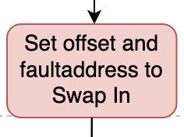
VM Fault 3/4

Slide 37
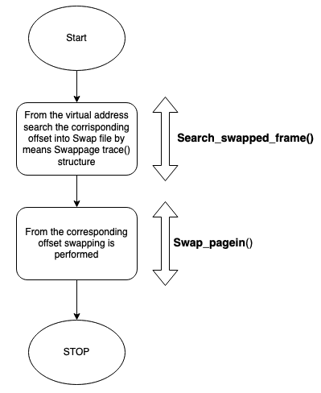
Swap IN 1/2

Slide 38
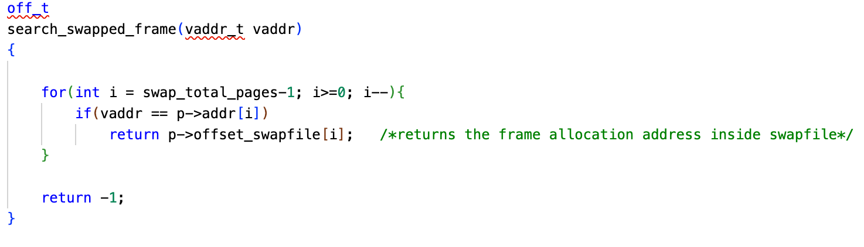
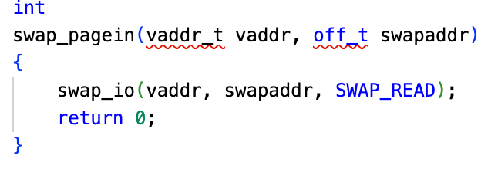
Swap IN 2/2
Search_swapped_frame(vaddr_t vaddr)
Swappage_IN(vaddr_t vaddr, off_t swapaddr)

Slide 39
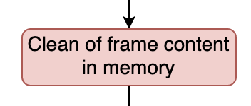
VM Fault 3/4

Slide 40
Clean Memory frame

Slide 41
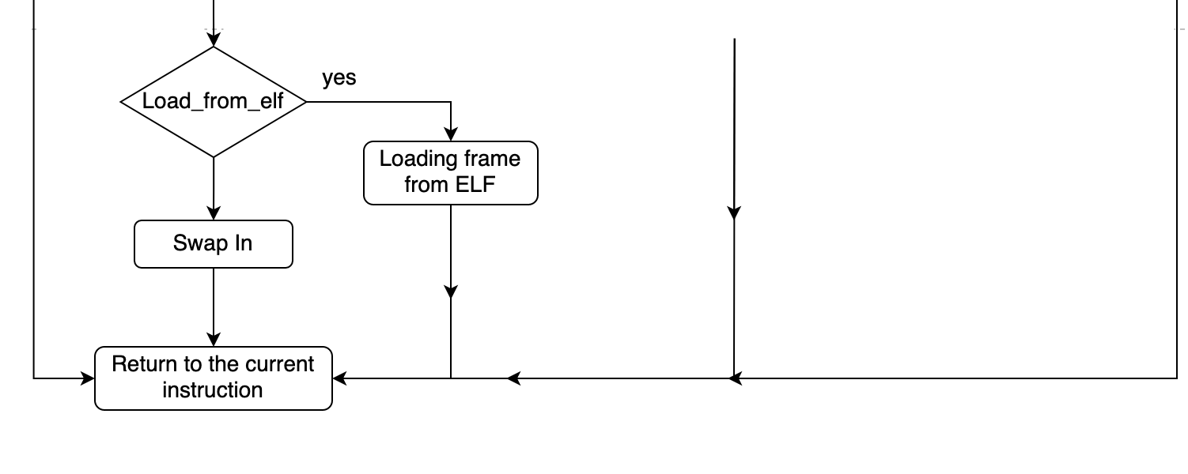
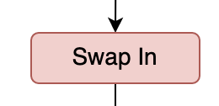
VM Fault 4/4

Slide 42
Swap In

Slide 43
Data structures

Slide 44
Data Structures – Frame Allocator
FRAME ALLOCATOR (MODIFICARE)
Performs page-to-frame translation
Access through the page number, the content accessed is the frame number
Used in case of TLB fault
FRAME ALLOCATOR - IMPLEMENTATION
Realized as a pointer to a «paddr_t» variable
Page Table length is dynamic
Each entry is a variable of type paddr_t
Access performed through the page number
Methods available to handle the page table:
paddr_t * pt_create(size_t nentries)
creates the page table by allocating «nentries» entries
void pt_destroy(paddr_t * pt_dest)
destroys the page table «pt_dest» by freeing resources allocated

Slide 45
Data Structures – Allocation Size
ALLOCATION SIZE (MODIFICARE)
Performs page-to-frame translation
Access through the page number, the content accessed is the frame number
Used in case of TLB fault
ALLOCATION SIZE - IMPLEMENTATION
Realized as a pointer to a «paddr_t» variable
Page Table length is dynamic
Each entry is a variable of type paddr_t
Access performed through the page number
Methods available to handle the page table:
paddr_t * pt_create(size_t nentries)
creates the page table by allocating «nentries» entries
void pt_destroy(paddr_t * pt_dest)
destroys the page table «pt_dest» by freeing resources allocated

Slide 46
Data Structures – Page Table
PAGE TABLE
Performs page-to-frame translation
Access through the page number, the content accessed is the frame number
Used in case of TLB fault
PAGE TABLE - IMPLEMENTATION
Realized as a pointer to a «paddr_t» variable
Page Table length is dynamic
Each entry is a variable of type paddr_t
Access performed through the page number
Methods available to handle the page table:
paddr_t * pt_create(size_t nentries)
creates the page table by allocating «nentries» entries
void pt_destroy(paddr_t * pt_dest)
destroys the page table «pt_dest» by freeing resources allocated

Slide 47
Data Structures – Page Table
PAGE TABLE - IMPLEMENTATION
Methods available to handle the page table:
paddr_t get_victim_frame(paddr_t *pt,uint8_t *entry_valid)
returns the victim frame of page_table «pt», located at the entry «entry_valid»
uint8_t get_victim_pt_index(uint8_t *entry_valid)
returns the page_table index specified by «entry_valid»
vaddr_t get_page_number(vaddr_t virtualaddr,uint8_t *entry_valid)
returns the page number, «virtualaddr» is the base virtual address, «entry_valid» the offset
void pt_update(paddr_t *pt,uint8_t *entry_valid,paddr_t new_frame,uint8_t nvalidentries,uint8_t new_pt_index)
updates the page table «pt» at the entry «new_pt_index» by storing «new_frame»
«entry_valid» is updated as well with «new_pt_index»

Slide 48
Data Structures – Entry Valid
ENTRY VALID
Contains the page table index of all the valid entries
Used to speed up the search for a valid entry through the page table
ENTRY VALID – IMPLEMENTATION
Realized as a pointer to a «uint8_t» variable
Each variable describes a page table index with a valid entry
Its length matches the number of frames allocated for user program execution
Methods available to handle the entry valid structure:
uint8_t get_victim_pt_index(uint8_t *entry_valid)
void pt_update(paddr_t *pt,uint8_t *entry_valid,paddr_t new_frame,uint8_t nvalidentries,uint8_t new_pt_index)
Both methods are already described in the previous slide

Slide 49
Data Structures – Free Frame List
FREE FRAME LIST
Handles the available frame addresses provided to the process
Works as a stack
Filled at the beginning, before the process starts execution
Gradually emptied, until no more frame are available (page replacement)
FREE FRAME LIST- IMPLEMENTATION
Realized as a pointer to a «ffl» structure
Each «ffl» structure is composed by:
A «paddr_t» variable representing the available frame
A pointer to the previous «ffl» structure
A pointer to the next «ffl» structure

Slide 50
Data Structures – Free Frame List
FREE FRAME LIST- IMPLEMENTATION
Methods available to handle the free frame list:
struct ffl * ffl_create(const uint8_t nframes)
Creates the free frame list and performs all the links between adjacent ffl structures, by assigning the proper address to pointers of next/previous «ffl» structure
void ffl_init(struct ffl ** ffl_init, uint8_t nframes)
Initializes the «ffl» structure by filling it with all the frames provided to the process
void ffl_push(struct ffl ** ffl_push, const paddr_t fr_push)
The pointer is moved to the next «ffl» structure, then it pushes to the «ffl» top an available frame
paddr_t ffl_pop(struct ffl ** ffl_pop)
Pops from the «ffl» top a frame to be used, then the pointer is moved to the previous «ffl» structure
void ffl_destroy(struct ffl * ffl_dest)
Destroys the free frame list

